Slide 1
Is there a correlation between Reddit.com/r/wallstreetbets stock sentiment and stock price?
Mario Hage

Slide 2
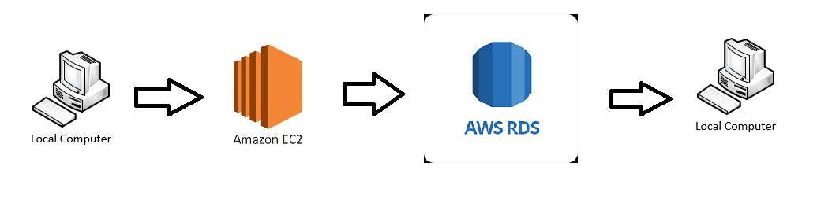
Project Architecture

Slide 3
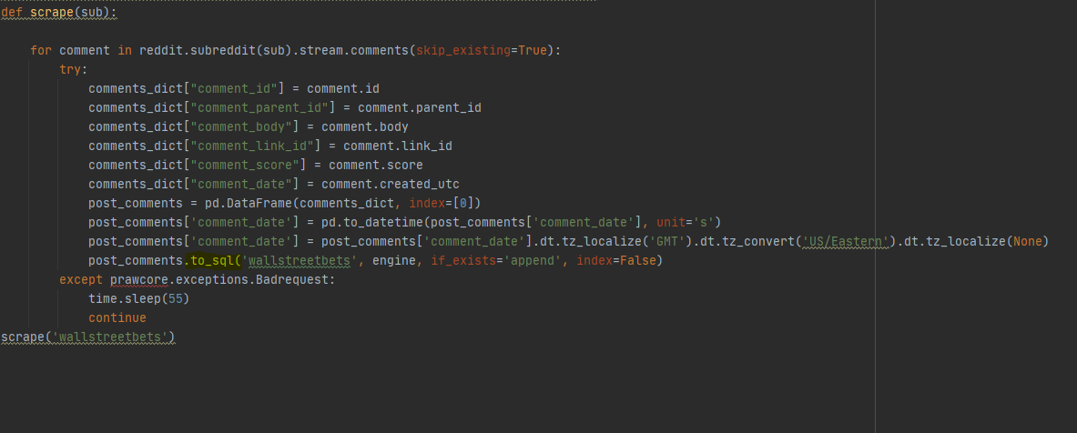
Data Collection - Reddit’s PRAW API
Using Reddit’s PRAW API: https://praw.readthedocs.io/en/latest/
I was able to scrape the subreddit and store the collected data into a SQL AWS RDS (highlighted in yellow in the code to the right.)

Slide 4
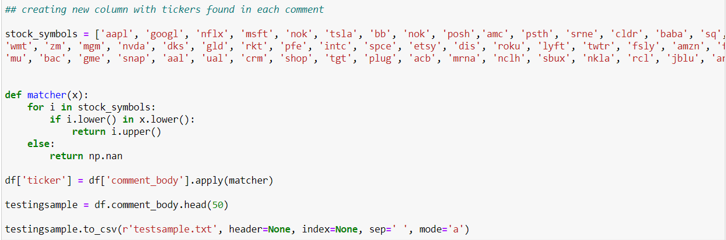

Extracting Stock Tickers from Comments/Cleaning Data
The piece of code below scans comments for a list of popular tickers and adds that ticker into a new column if it exists in a specific comments
The piece of code below filters for comments with a len < 150

Slide 5
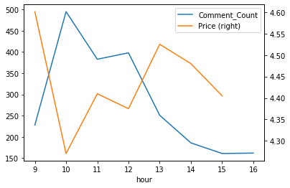
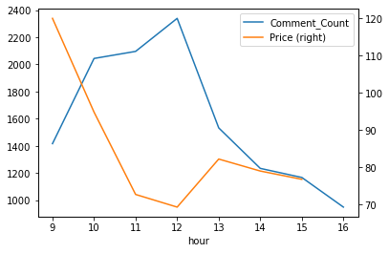
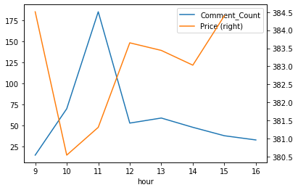
Price vs Comment Count Correlation? (Popular Stocks Shown)
AMC
GME
SPY

Slide 6
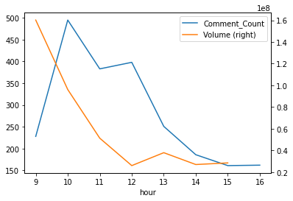
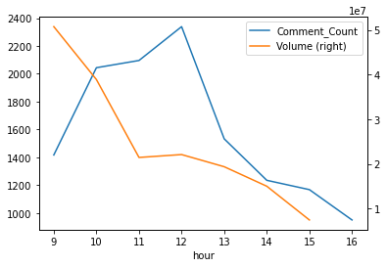
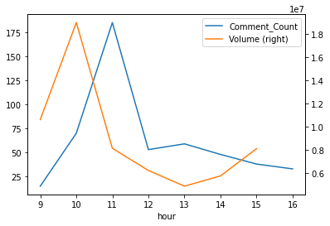
Stock Volume vs Comment Count Correlation? (Popular Stocks Shown)
AMC
GME
SPY

Slide 7
Volume/Price/Comment Count Verdict?
As you can see from the above 2 slides, there seems to be a correlation between stock trading volume and reddit.com/r/wallstreetbets comment count.
There does NOT seem to be any correlation between stock price and comment count.

Slide 8
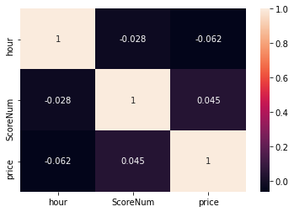
Sentiment Analysis/Correlation
Model used: ProsusAI/finbert: https://huggingface.co/ProsusAI/finbert
Aggregated Correlation across all stocks can be seen to the right, as you can see there is little to no correlation between Stock Price and Sentiment. Even stocks are observed and analyzed individually, there were no stocks that showed correlation. The statement that “you cannot predict the stock market” holds true.

Slide 9

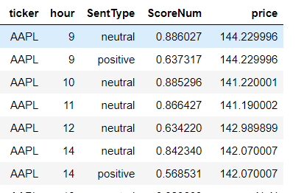
Sentiment Analysis/Correlation
Examples
ScoreNum = (Mean score grouped by hour/Sentiment Type)
Example Scoring

Slide 10
Wrap Up
A big thank you to Konstantin Palagachev, my mentor who helped provide direction, feedback, pushed me to learn new technologies (AWS EC2, AWS RDS)
Useful Links: https://huggingface.co/ProsusAI/finbert
https://praw.readthedocs.io/en/latest/

